Slide 1

Predicting Average Localization Error in Wireless Sensor Networks
Mentor: Sudhanshu Gonge
Kaustubh Raykar
Srinivas Kota

Slide 2

Introduction
WSNs are vital for data collection in remote areas.
Predicting error is essential for enhancing accuracy and efficiency.
Our research evaluates supervised machine learning algorithms.
Let's explore the significance and results of our work.

Slide 3

About the Dataset
Predicting Ale in WSN’s dataset contains 107 rows and 5 columns which are anchor ratio, node density, trans range, iterations, ale. This dataset is obtained from UCI which is a valuable resource for the development and evaluation of Ale in wsn’s.

Slide 4

Objective
Forecasting the average localization error in wireless sensor networks (WSNs) is crucial for several reasons:
Accuracy: Precise location information is essential for various WSN applications. Predicting localization errors helps optimize algorithms and enhance system accuracy.
Resource Management: Anticipating the error allows efficient resource allocation, such as placing anchor nodes strategically or adjusting node transmission power for improved accuracy and energy efficiency.
Network Performance: Understanding localization errors helps identify network bottlenecks and enhances network parameters and service quality.
Fault Detection and Repair: Predicted errors can aid in detecting and fixing network issues, including failing nodes and localization process problems.
Scalability: As WSNs grow in size and complexity, predicting localization errors is vital for maintaining performance and reliability, enabling the design of scalable solutions.

Slide 5
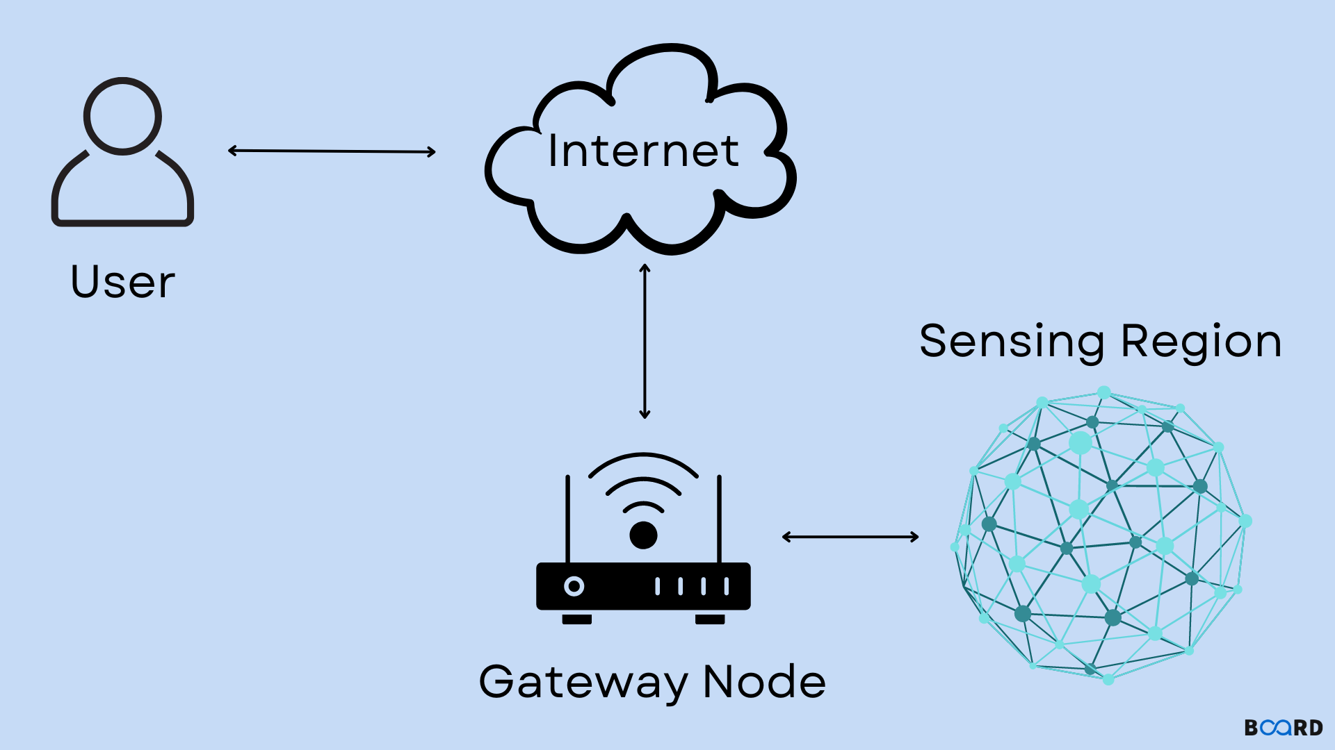
WSN OVERVIEW
What are WSNs: Wireless Sensor Networks (WSNs) are networks of small, distributed sensors.
Applications: They play a critical role in various applications, such as environmental monitoring, precision agriculture, and industrial automation.
Precise Localization: In WSNs, achieving accurate and precise localization is essential to ensure that sensor nodes can perform their tasks effectively and efficiently.

Slide 6
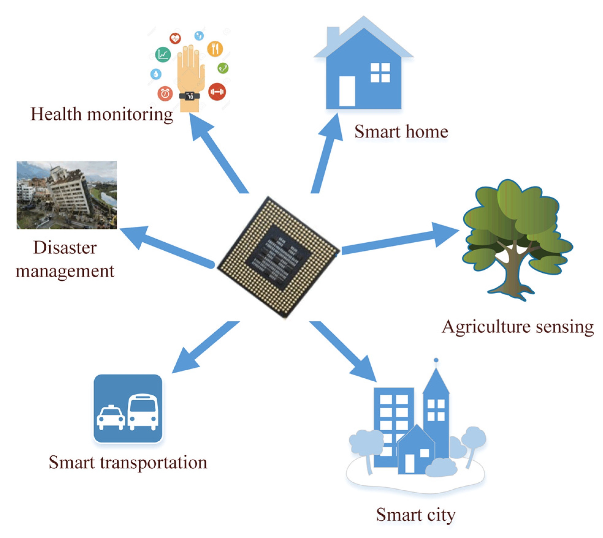
MOTIVATION
Need for Error Prediction: Error prediction in Wireless Sensor Network (WSN) applications is driven by the critical necessity to preemptively identify and mitigate potential issues. It enables the enhancement of WSN performance and reliability.
Consequences of WSN Errors: Errors in WSNs can lead to data loss, network outages, and disruption in various applications, including environmental monitoring, industrial automation, and healthcare. Accurate error prediction can significantly improve the overall utility of WSNs in these critical domains.

Slide 7
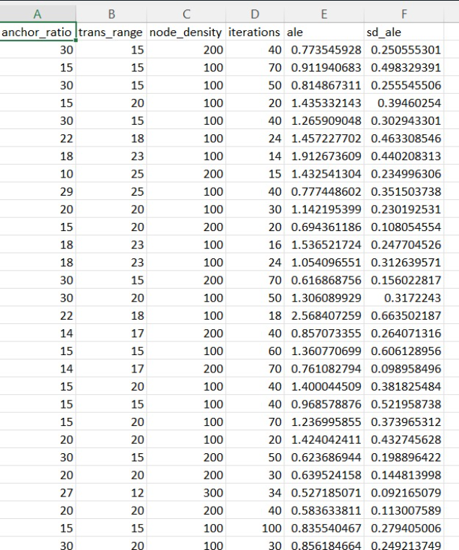
WSN DATASET
What are WSNs: Wireless Sensor Networks (WSNs) are networks of small, distributed sensors.
Applications: They play a critical role in various applications, such as environmental monitoring, precision agriculture, and industrial automation.
Precise Localization: In WSNs, achieving accurate and precise localization is essential to ensure that sensor nodes can perform their tasks effectively and efficiently.

Slide 8
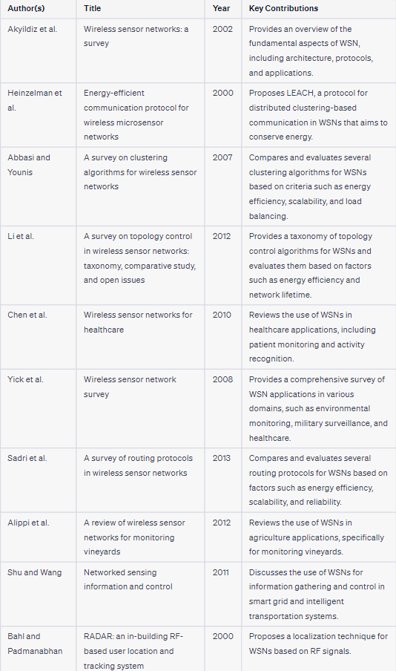
WSN DATASET
LITERATURE SURVEY

Slide 9
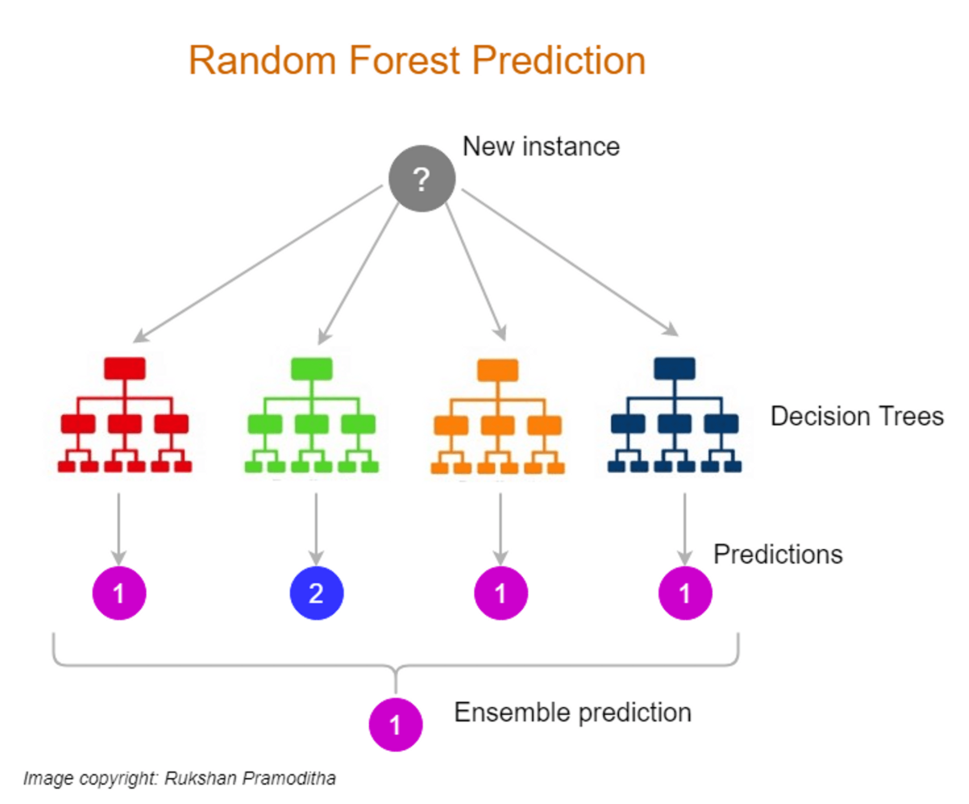
ALGORITHMS USED
Random Forest Regressor
Exploratory Data Analysis

Slide 10
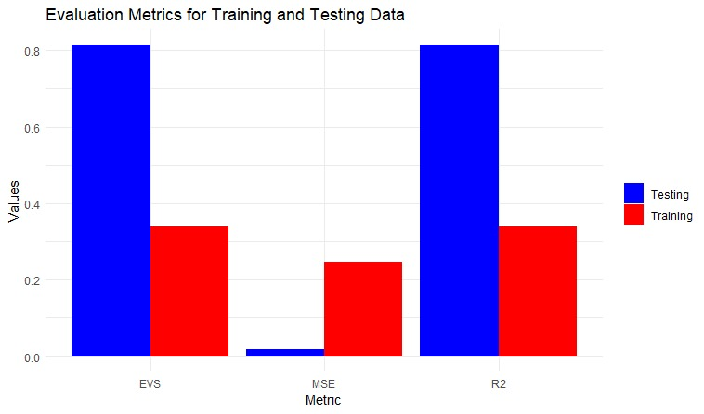
RESULTS
MSE (Mean Squared Error): 0.0179
RMSE (Root Mean Squared Error): 0.1336
Training Set Evaluation Metrics:
Mean squared error (MSE): 0.25
R-squared (R2): 0.34
Explained variance score (EVS): 0.34
Testing Set Evaluation Metrics:
Mean squared error (MSE): 0.02
R-squared (R2): 0.82
Explained variance score (EVS): 0.82

Slide 11
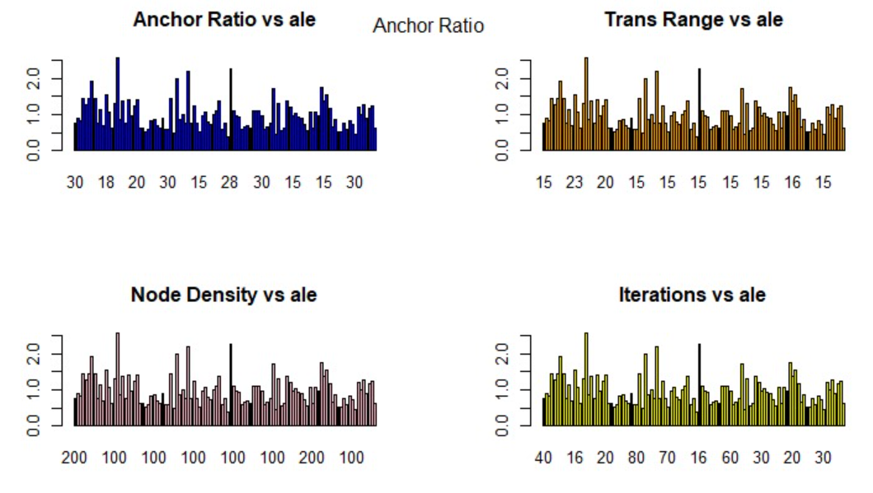
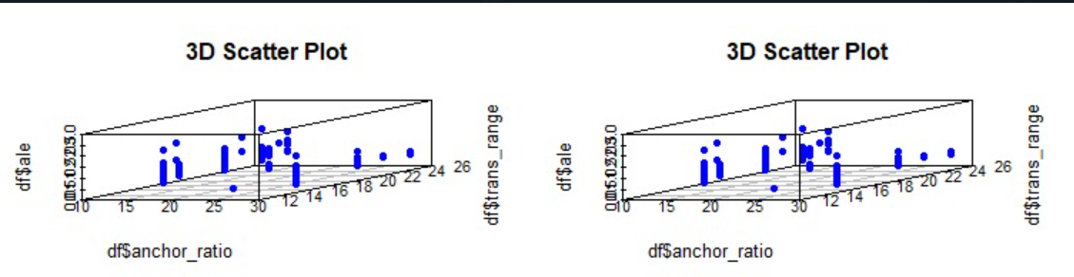
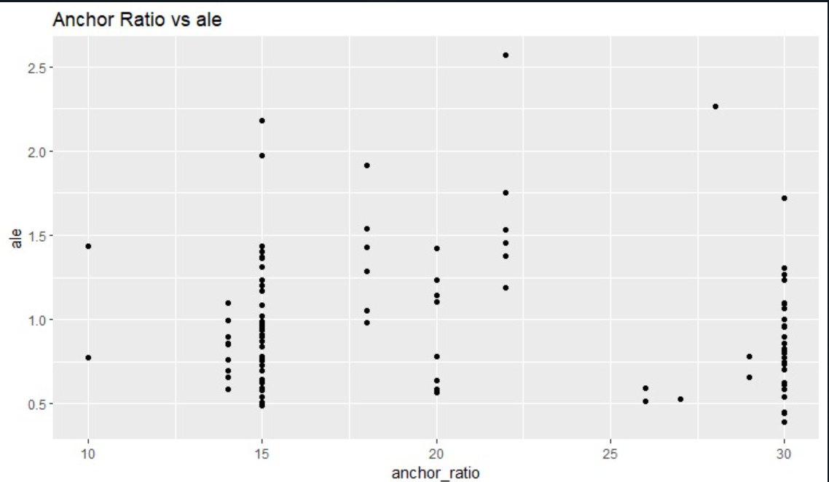
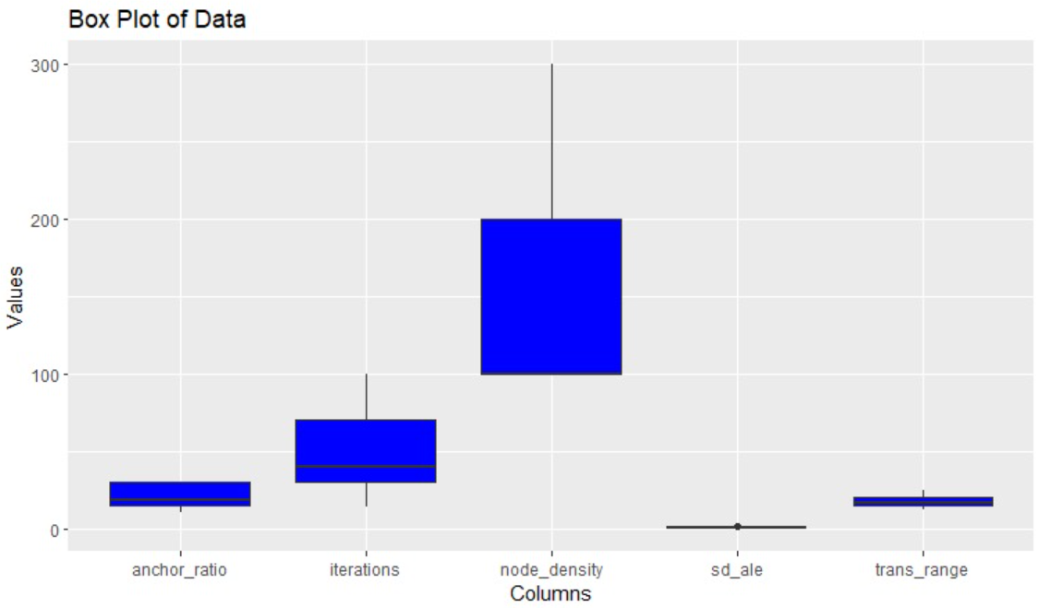
EDA GRAPHS

Slide 12
CONCLUSION
In conclusion, our research has revealed the significant impact of supervised machine learning algorithms on the accuracy and efficiency of Wireless Sensor Networks (WSNs).
The latest results reflect promising model performance, with a low MSE and improved R2 scores, demonstrating the potential of our approach.
These findings underline the importance of accurate error prediction in WSN applications, enhancing their reliability and utility.
Future research directions should focus on energy-efficient algorithms, advanced machine learning methods, and interdisciplinary applications, ensuring the continuous advancement of WSN technology.

Slide 13

Thank You

